Slide 1



Mahadevi Birla Shishu Vihar
At

Slide 2

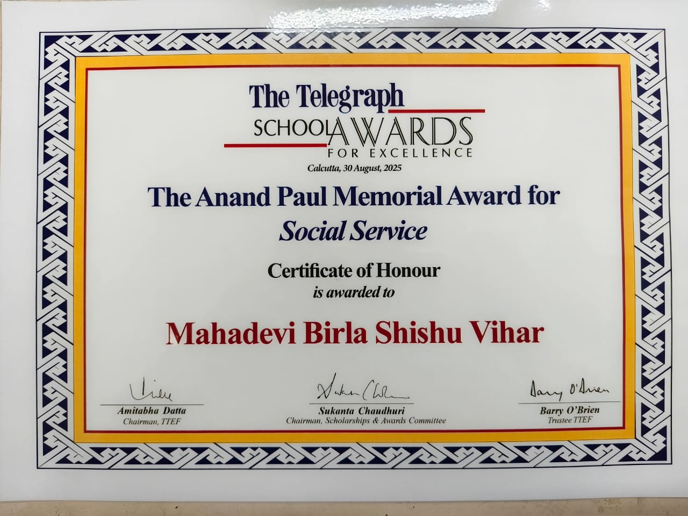




Slide 3
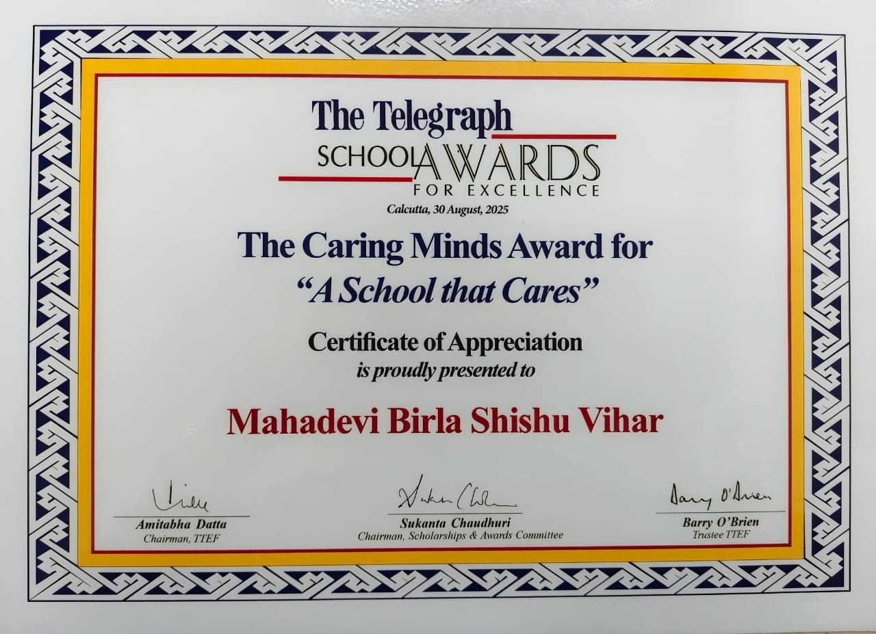

Slide 4
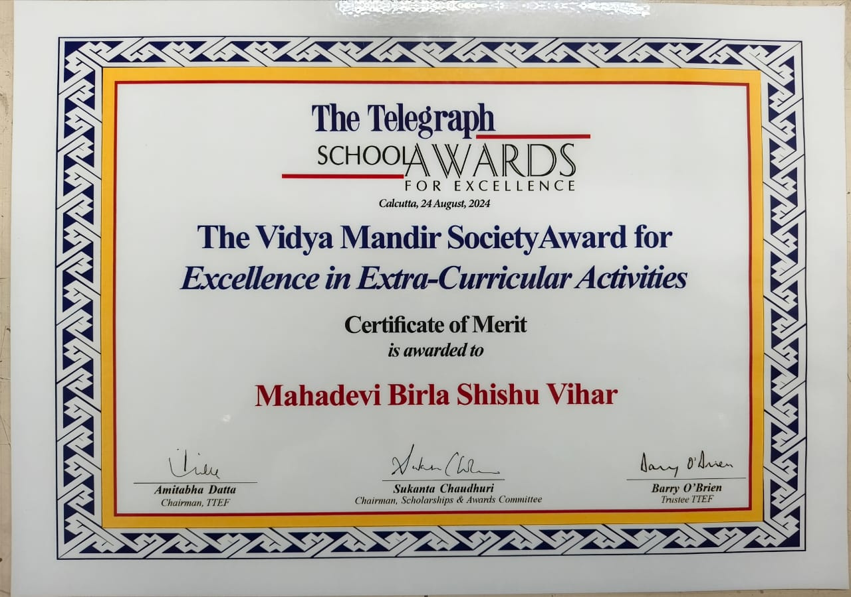

Slide 5
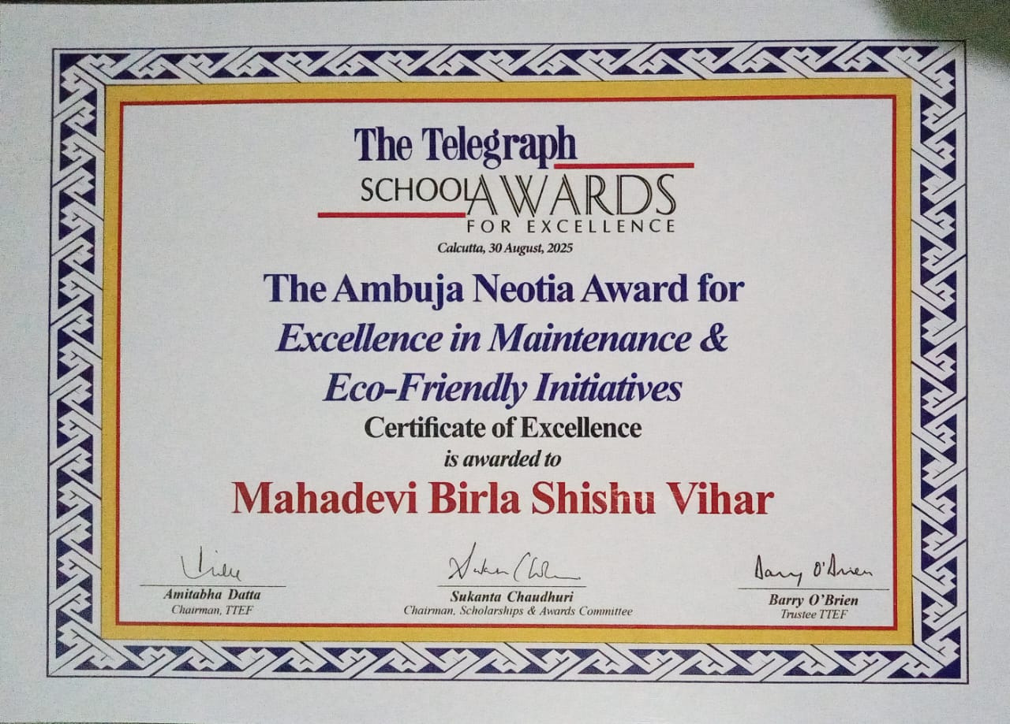

Slide 6
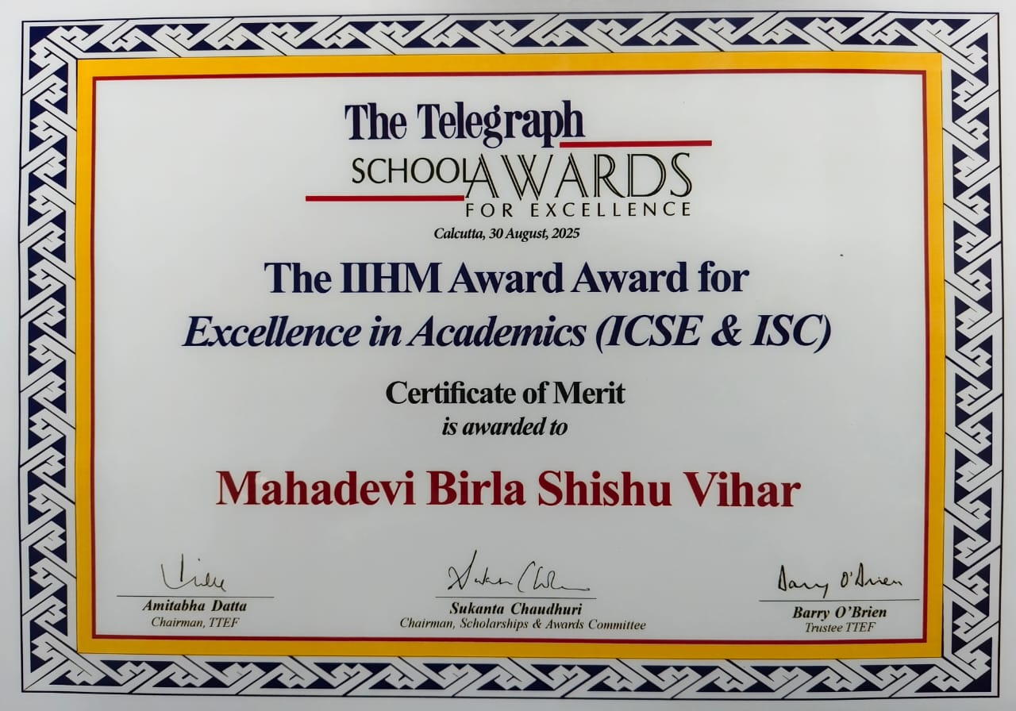

Slide 7
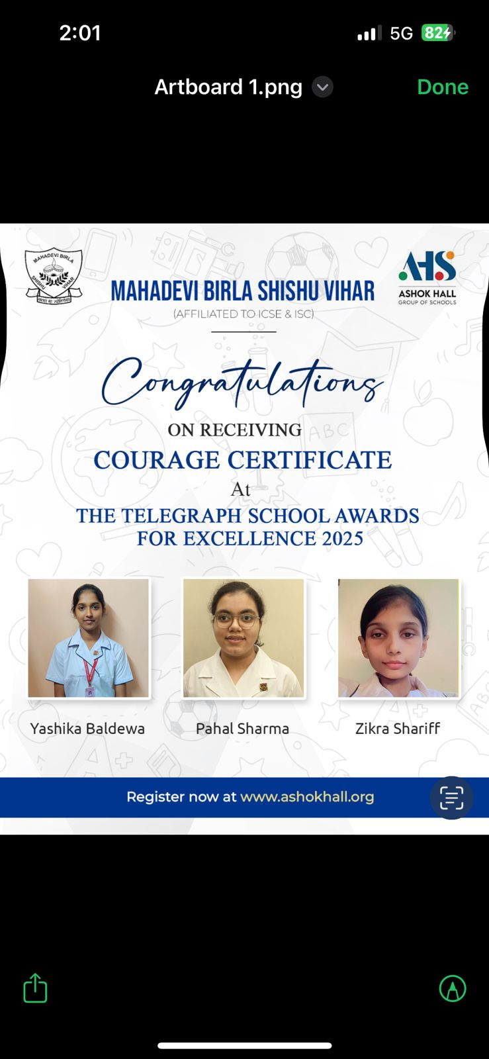
CONGRATULATIONS ON RECEIVING
COURAGE CERTIFICATE
AT
THE TELEGRAPH SCHOOL AWARDS

Slide 8
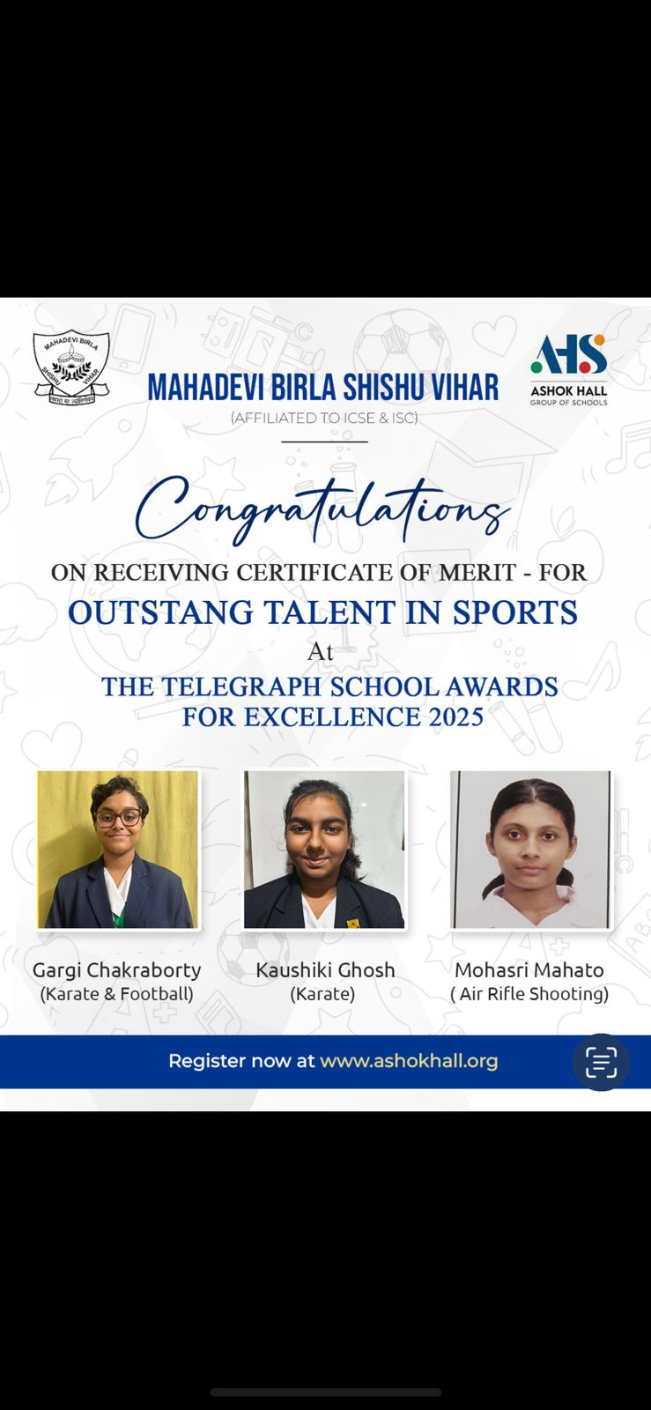
CONGRATULATIONS ON RECEIVING CERTIFICATE OF MERIT
AT
THE TELEGRAPH SCHOOL AWARDS FOR SPORTS 2025

Slide 9
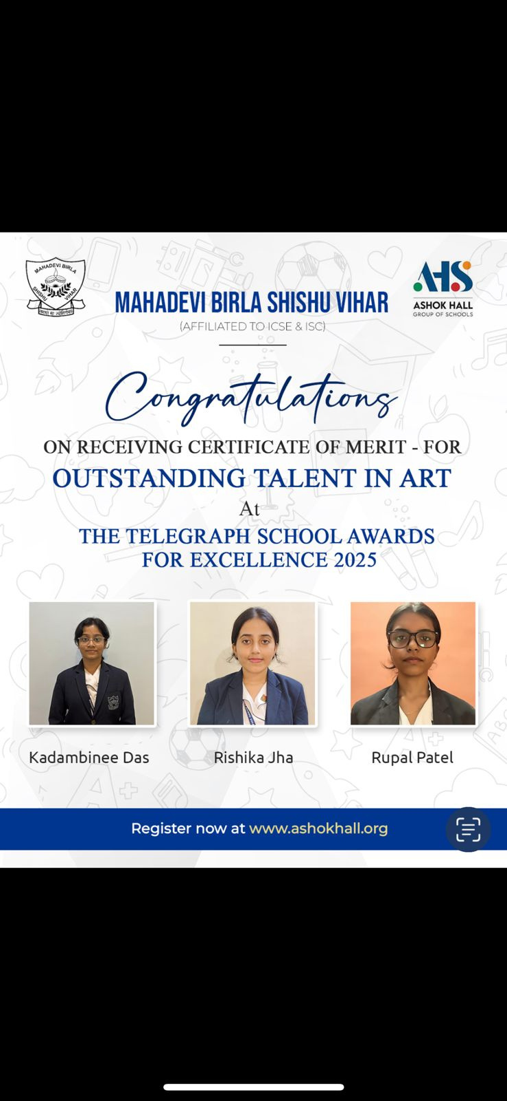
CONGRATULATIONS ON RECEIVING CERTIFICATE OF MERIT
AT
THE TELEGRAPH SCHOOL AWARDS FOROUTSTANDING TALENT IN ART 2025

Slide 10

CONGRATULATIONS ON RECEIVING CERTIFICATE OF MERIT
AT
THE TELEGRAPH SCHOOL AWARDS FOR
OUTSTANDING TALENT IN MUSIC 2025

Slide 11
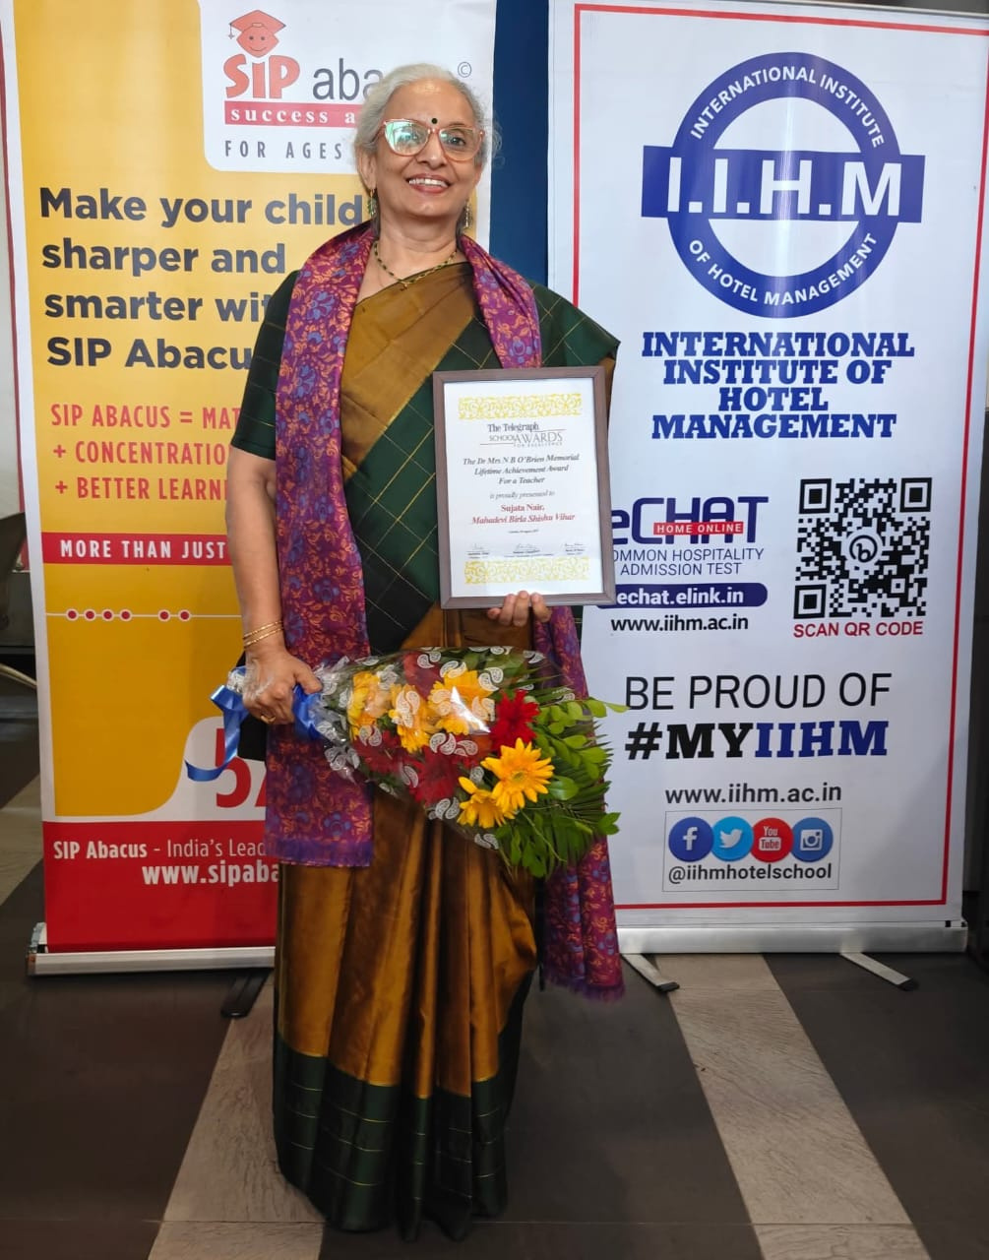
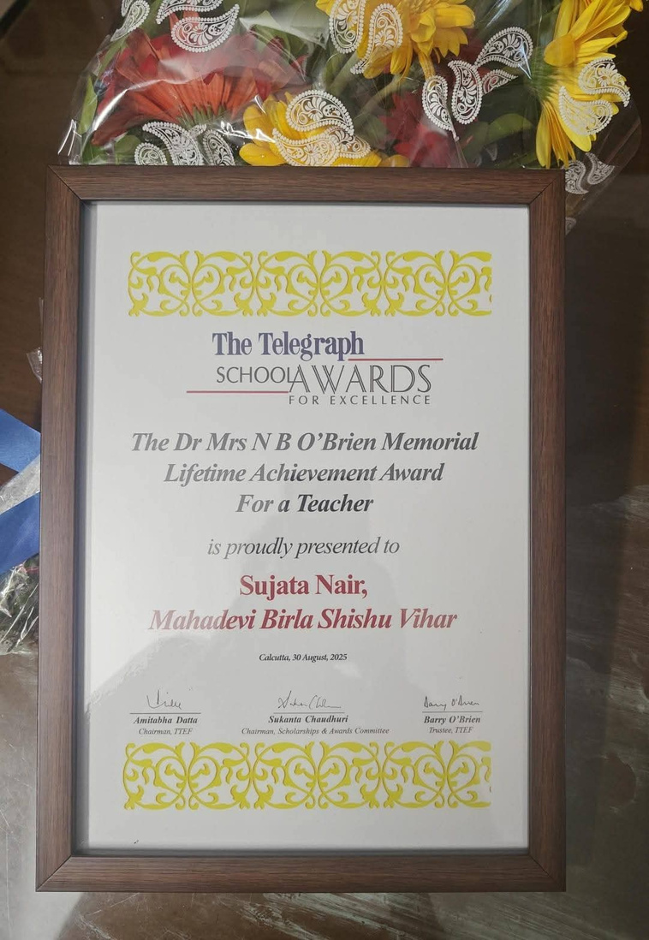
CONGRATULATIONS
ON RECEIVING
LIFETIME ACHIEVEMENT AWARD
AT
THE TELEGRAPH SCHOOL AWARDS
2025

Slide 12
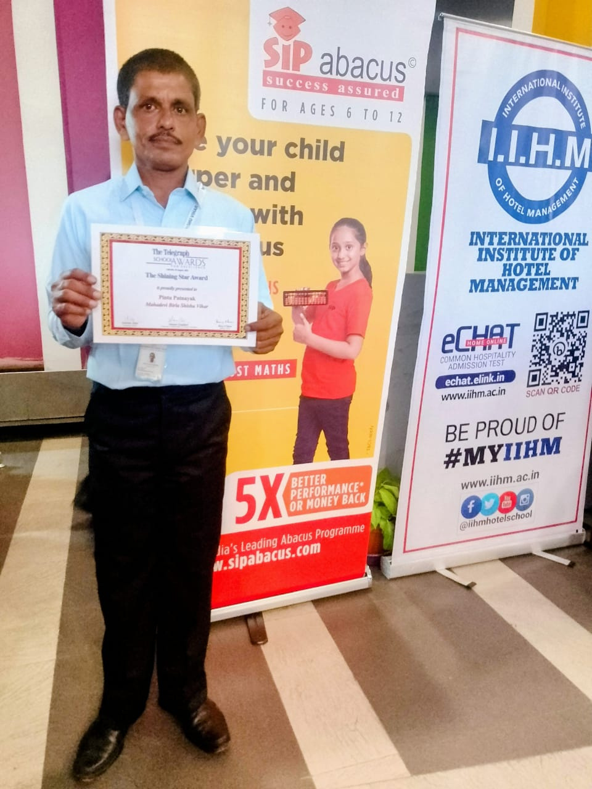
CONGRATULATIONS
ON RECEIVING
SHINING STAR AWARD
AT
THE TELEGRAPH SCHOOL AWARDS
2025

Slide 13
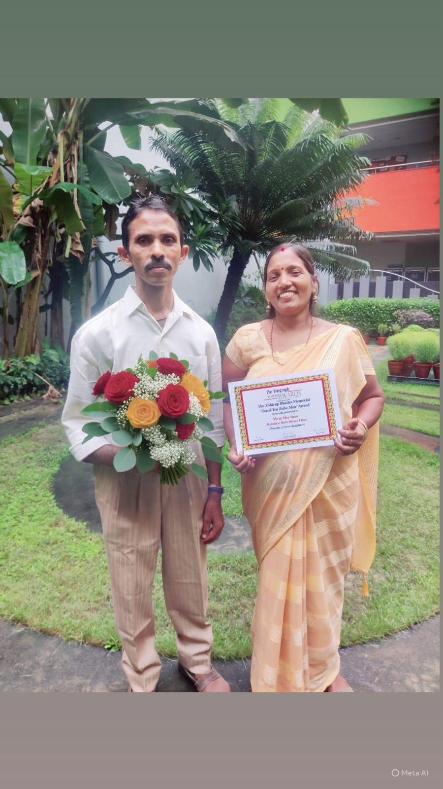
CONGRATULATIONS
ON RECEIVING
BABA MA AWARD
AT
THE TELEGRAPH SCHOOL AWARDS
2025

Slide 14



